Slide 1

FIRST Robotics Competition
By Matthew Stringer

Slide 2

What is Stem
STEM stands for “Science, Technology, Engineering, and Mathematics”
STEM jobs are projected to grow 13% from 2017 to 2027
93% of STEM jobs have wages higher than the national average
Notes:
Stem is Science, Technology, Engineering, and Math
Stem jobs are projected to grow 13% in 10 years
93% of Stem jobs are higher than the national average

Slide 3
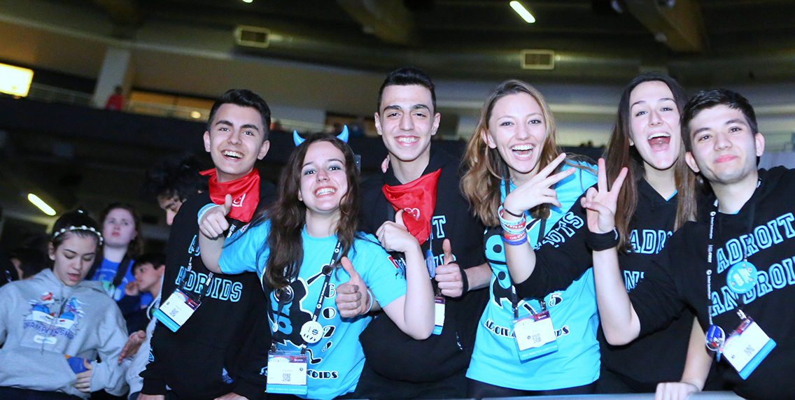
What is FIRST
FIRST stands for “For Inspiration and Recognition of Science and Technology”
FIRST is a nonprofit organization that works to inspire students to pursue STEM
Notes:
FIRST stands for “For Inspiration and Recognition of Science and Technology”
FIRST is an organization that tries to make people passionate about stem

Slide 4
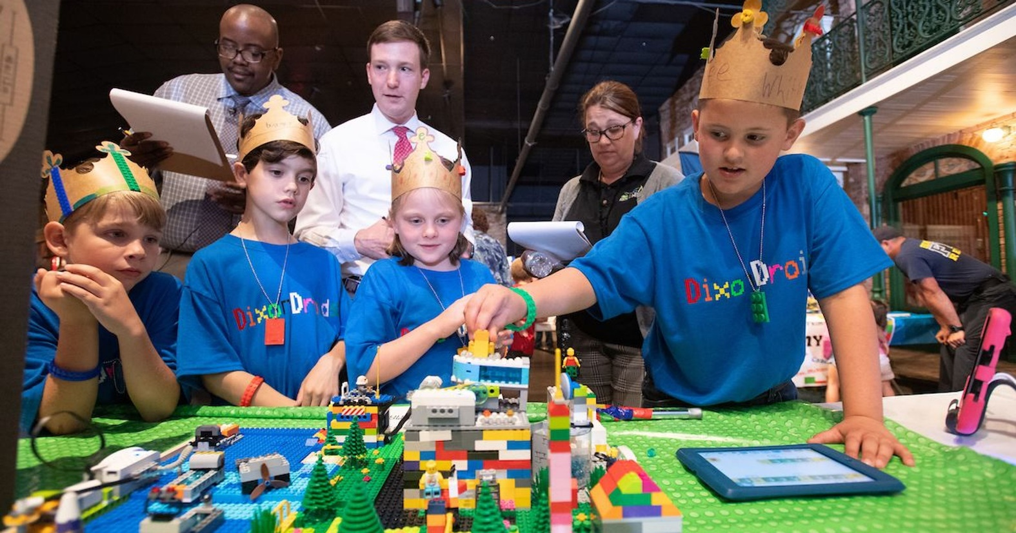
FIRST Lego League Jr
Introduces young children to science and coding concepts through hands-on, playful building challenges.
Grades K-4
Notes:
Teaches children science and coding through hands-on building challenges
For grades K-4

Slide 5
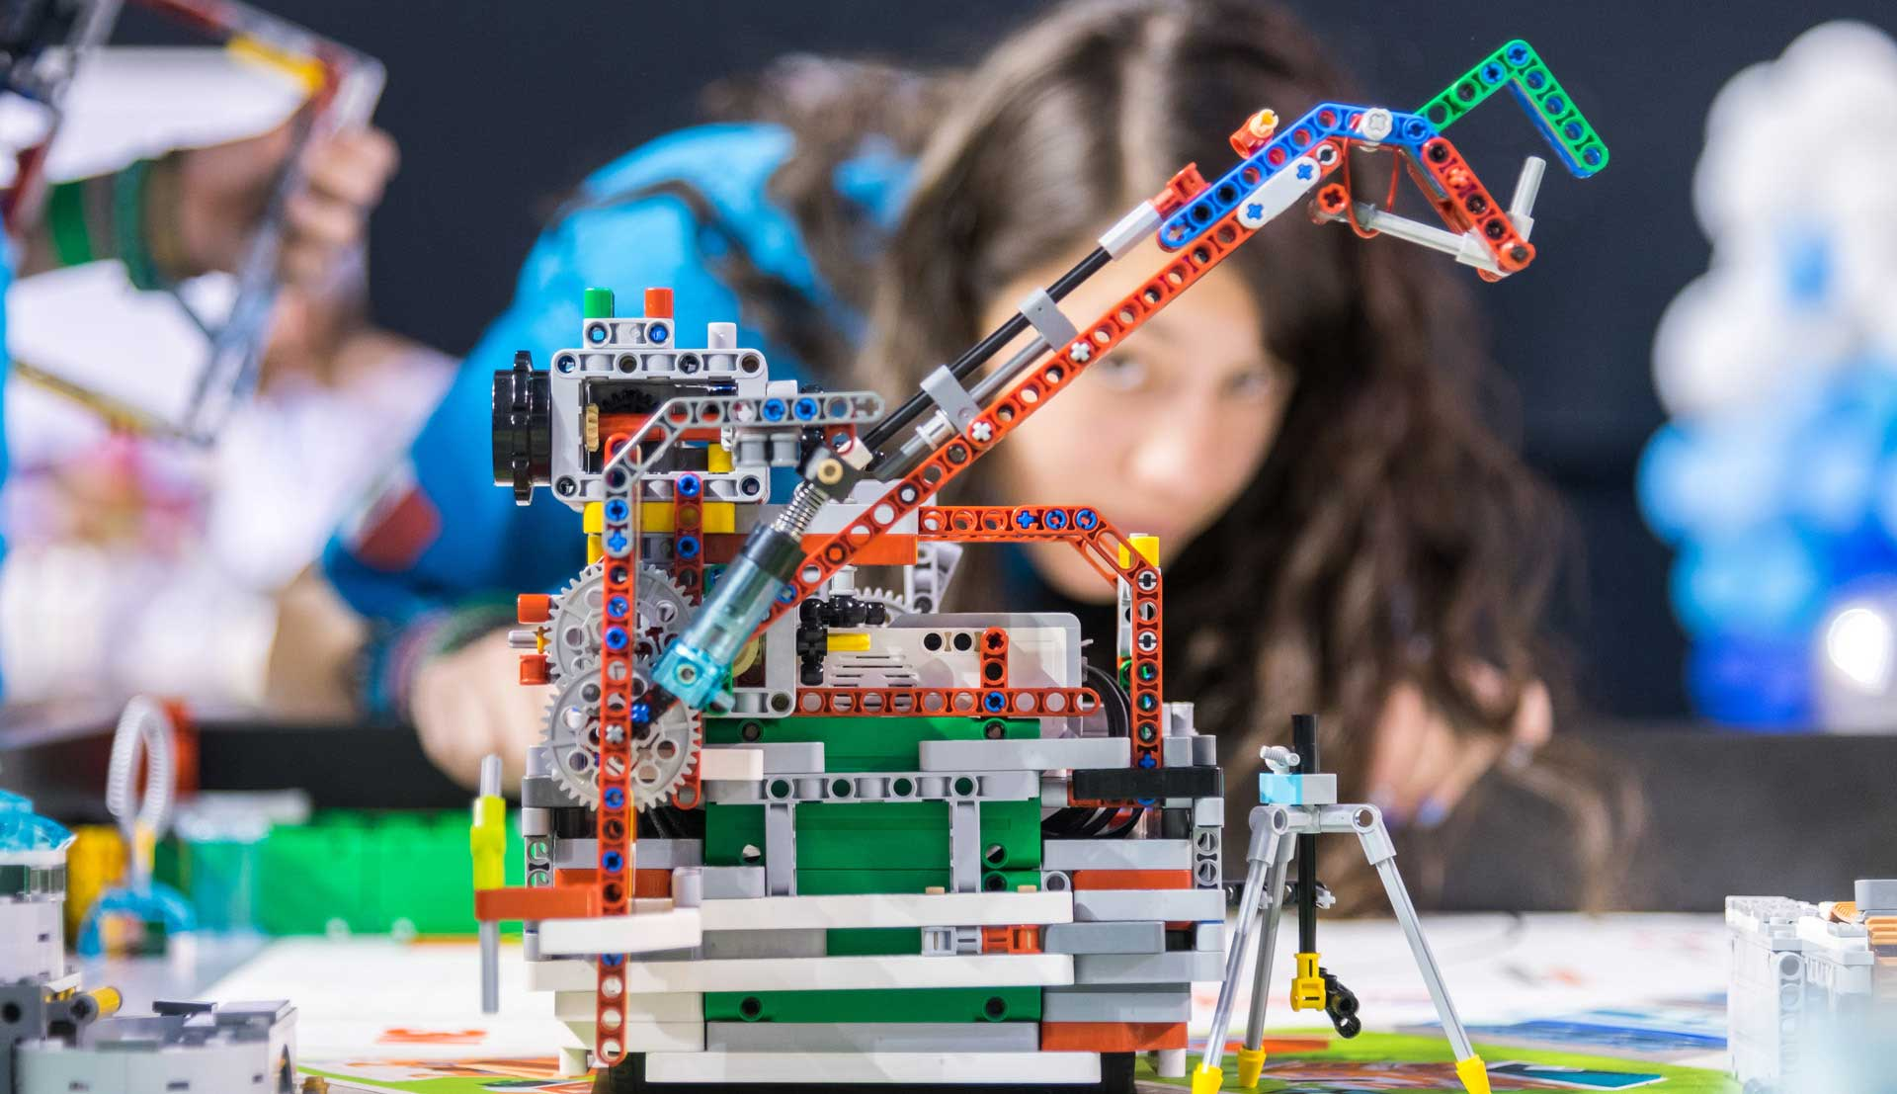
FIRST Lego League
Students program autonomous robots and design an innovative solution related to the annual theme.
Grades 4-8
Notes:
Students automatic robots and create custom solutions related to the annual theme
Grades 4-8

Slide 6
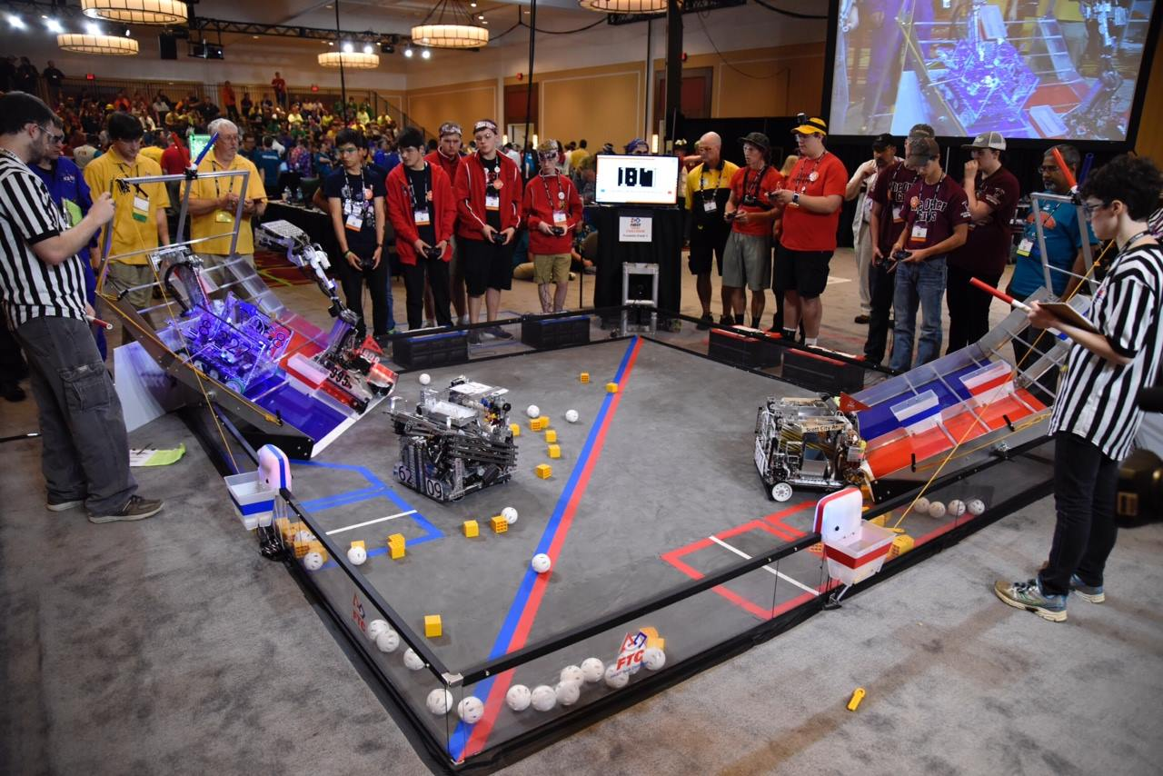
FIRST Tech Challenge (FTC)
Teams design, build, and program robots, develop strategy, and engage in thrilling, head-to-head competition.
Grades 7-12
Notes:
Teams build and program robots and play thrilling, head-to-head competition
For grades 7-12

Slide 7
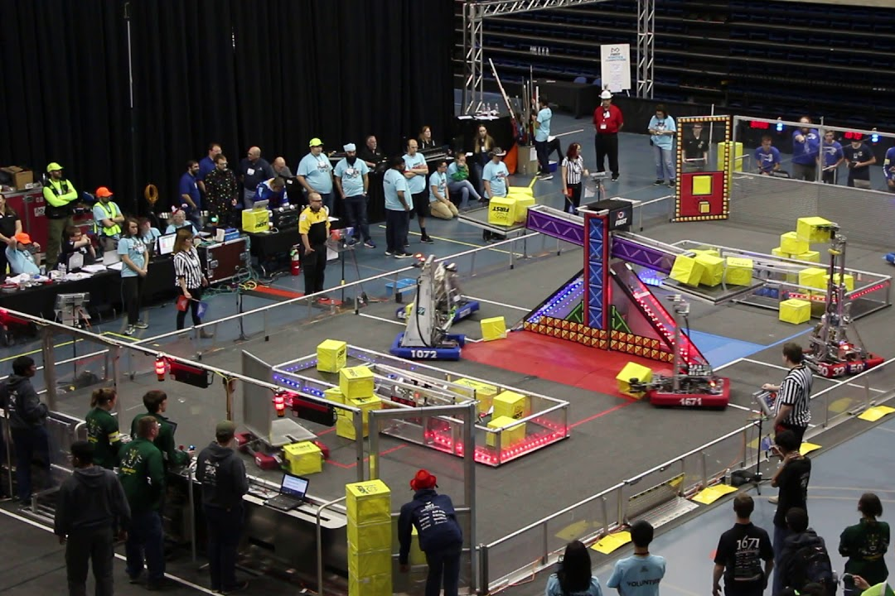
FIRST Robotics Competition (FRC)
Teams compete with 125-pound robots, combining the excitement of sport with the rigors of science and technology
The robot must follow strict rules from a manual
Teams of high school students are challenged to build industrial-size robots to play a difficult field game in alliance with other teams
Grades 9-12
Notes:
Teams make 125-pound robots
Combines the excitement of sport with science and technology
For high-schoolers (9-12)

Slide 8
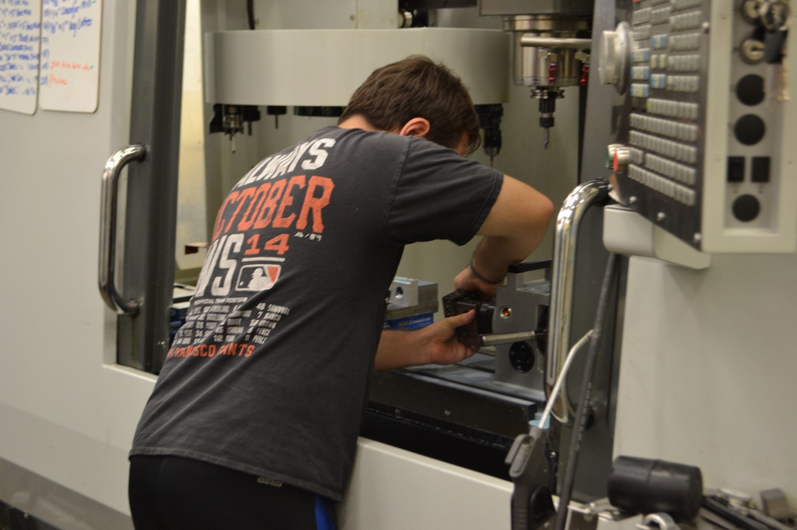
You get to
Design and program
Work alongside professional engineers
Build and compete with a robot of their own design
Notes:
While in FIRST, you get to
Design and program
Learn from engineers
Design your own robot

Slide 9
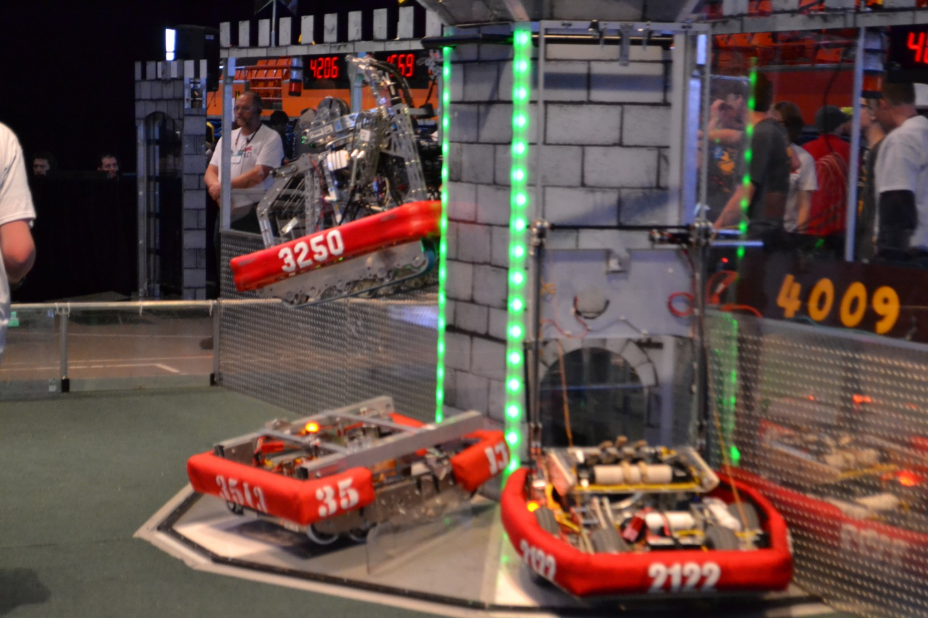
Impact
75% of FIRST Alumni are in a STEM Field as a student or professional
2 times as likely to show gains in their interest of STEM
87% of participants plan to take a more challenging Math or Science Course
FIRST Alumni are 2.6 times more likely to enroll in an engineering course their freshman year
Notes:
75% of alumni are in the stem field
87% of participants take more challenging math and science courses
Alumni are 2.6 likely to take an engineering course while in college

Slide 10
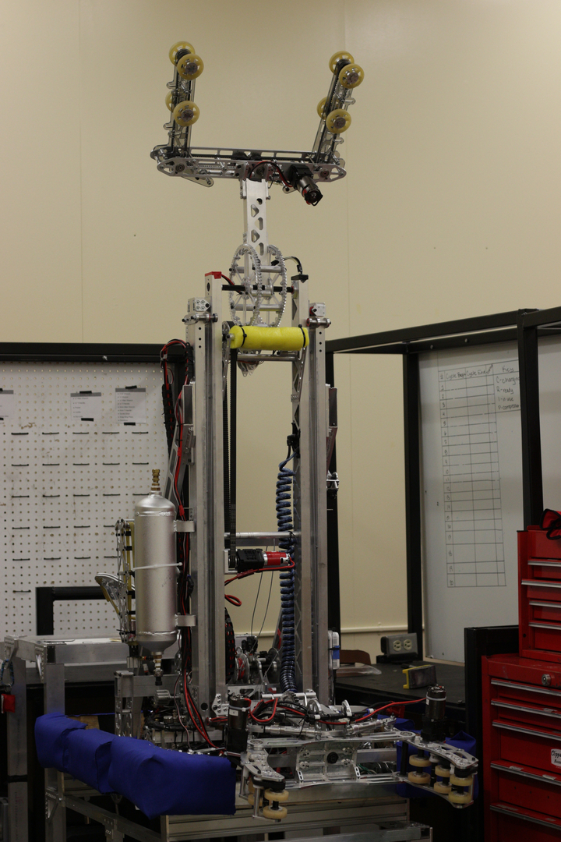
Build Season
Starts in early January
6 weeks to design, build, and program your robot
Over 5 hours a day after school each day
Notes:
Build season starts in January and lasts for 6 weeks
We spend over 5 hours a day after school working on our robot
Here is one of our robots from last year!

Slide 11
Kennedy Robotics (3250) Robot 2018

Slide 12
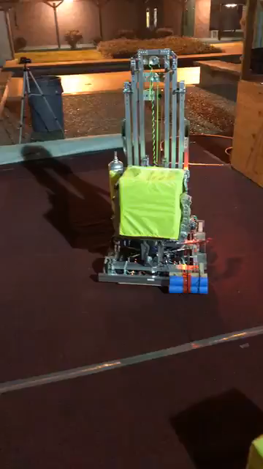
Running the 2018 robot for the first time

Slide 13
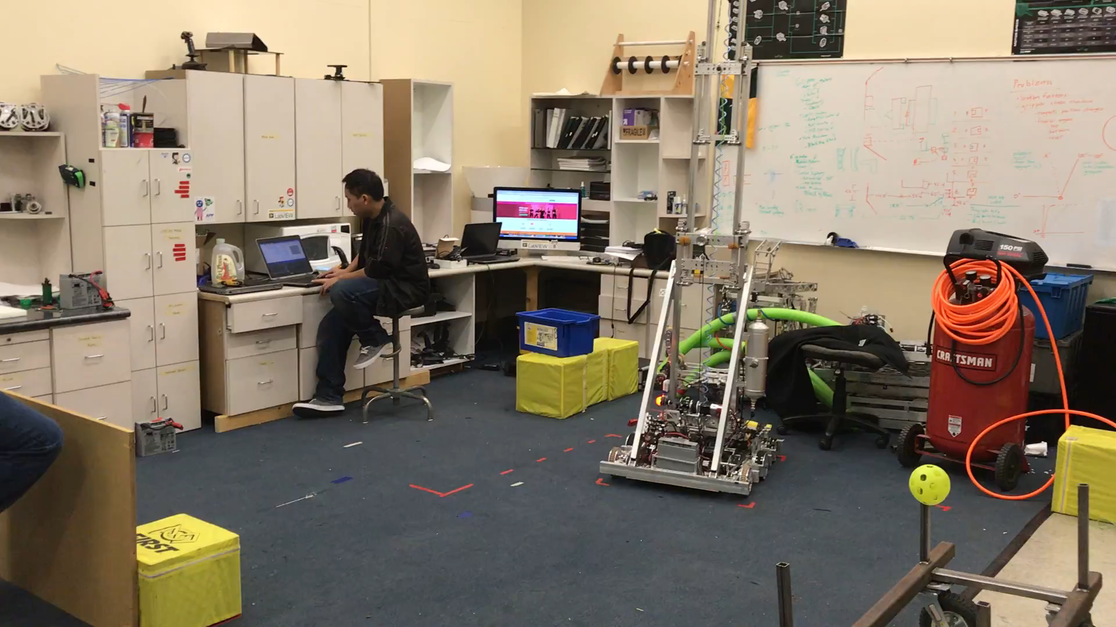
Testing Automatic code

Slide 14
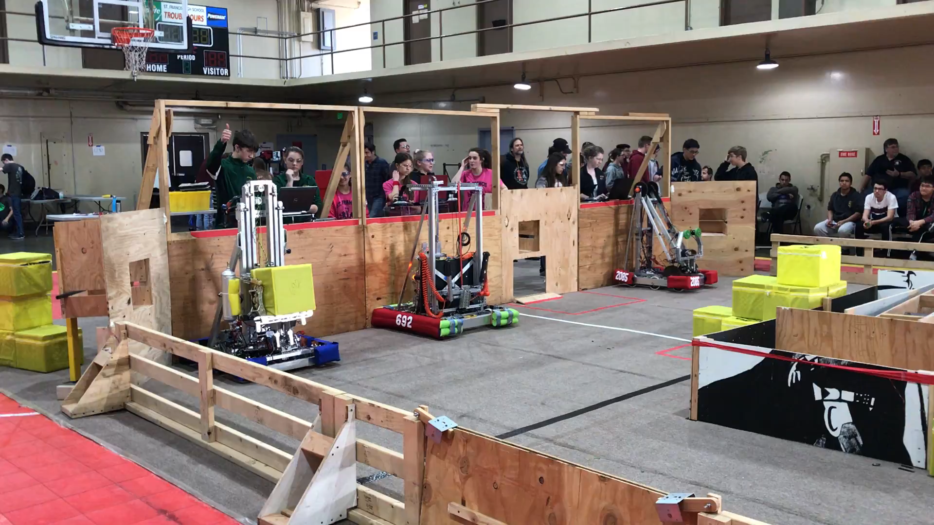
Running Automatic Code on Practice day

Slide 15
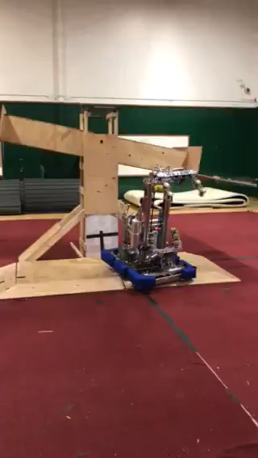
2018 Climb Testing

Slide 16
Why is robotics fun?
You get to design and program your own robot
You get to compete with students just like you
The robots do funny things like
Crash
Fall
Climb
Get stuck in the field
Throw things
Its really fun to WIN!

Slide 17
School Outreach
Middle Schools
Elementary Schools
Sutter Middle School
Address: 3150 I St, Sacramento, CA 95816
Phone: (916) 395-5370
San Brannan Middle School
Address: 5301 Elmer Way, Sacramento, CA 95822
Phone: (916) 395-5360
California Middle School
Address: 1600 Vallejo Way, Sacramento, CA 95818
Phone: (916) 395-5302
Pony Express Elementary
Address: 1250 56th Ave, Sacramento, CA 95831
Phone: (916) 395-4690
Caroline Wenzel
Address: 6870 Greenhaven Dr, Sacramento, CA 95831
Phone: (916) 433-5432
Matsuyama Elementary
Address: 7680 Windbridge Dr, Sacramento, CA 95831
Phone: (916) 395-4650

